Slide 1

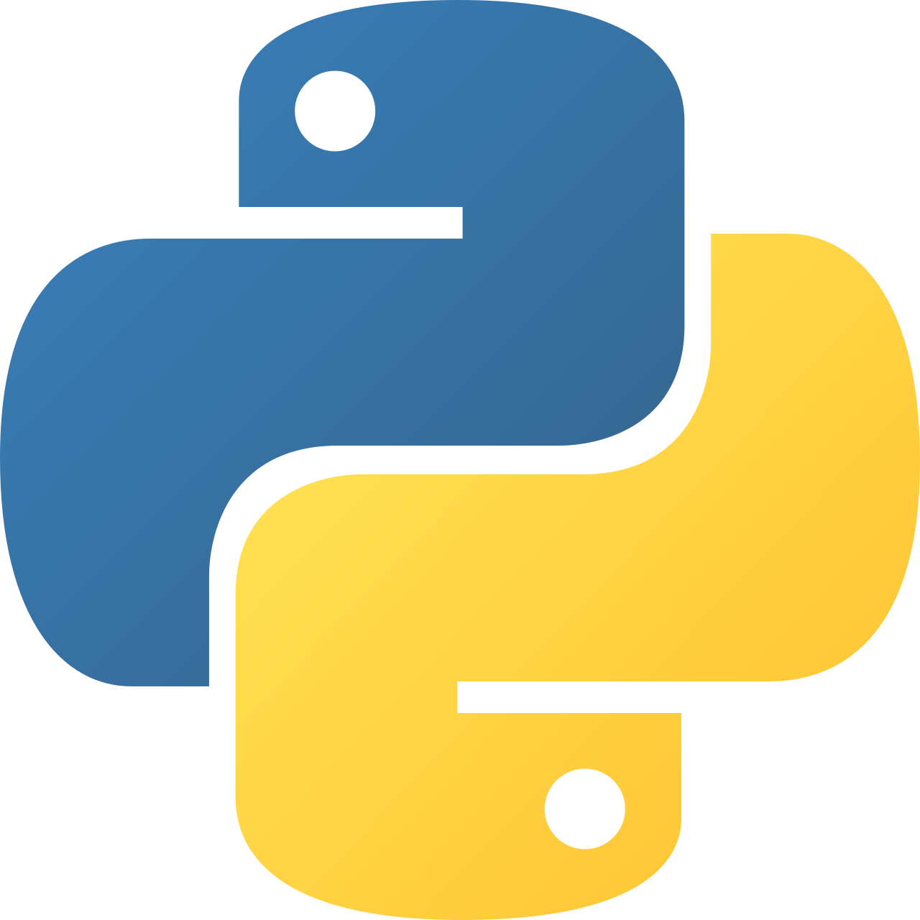
Intermediate Python
Modules – The Big Picture

Slide 2
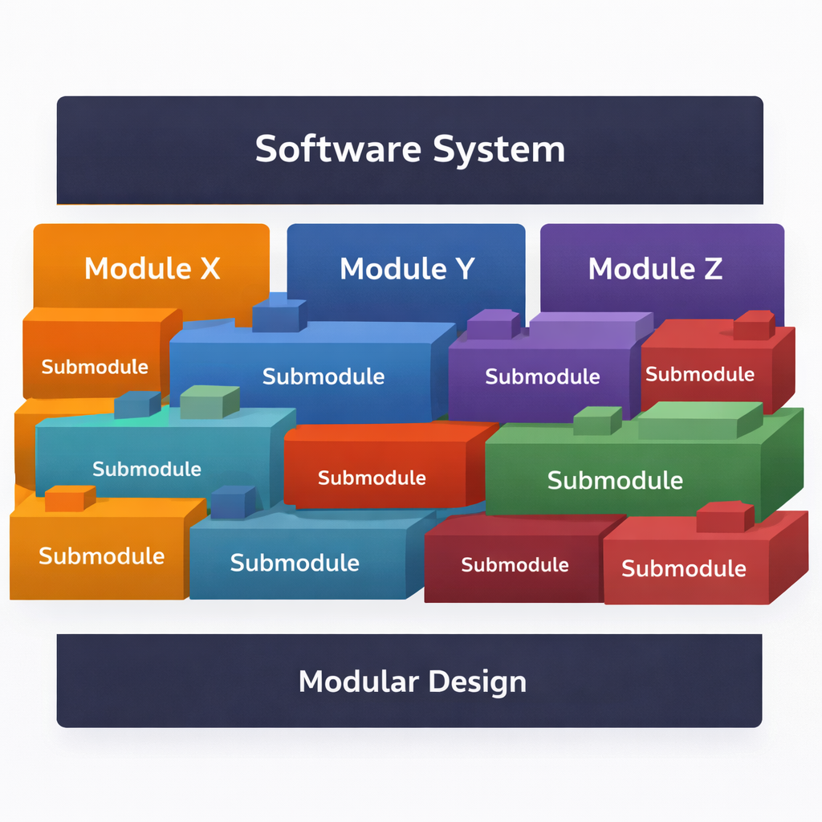
Why Use Modules?
Break large programs into manageable pieces
Promote code reuse across projects
Improve readability and organization
Enable team collaboration
Simplify testing and maintenance
Notes:
Explain how logic is separated into files. Emphasize that math_utils.py can now be reused in many projects without rewriting code.

Slide 3
Code Example
# math_utils.py
def add(a, b):
return a + b
# main.py
import math_utils
print(math_utils.add(2, 3))

Slide 4
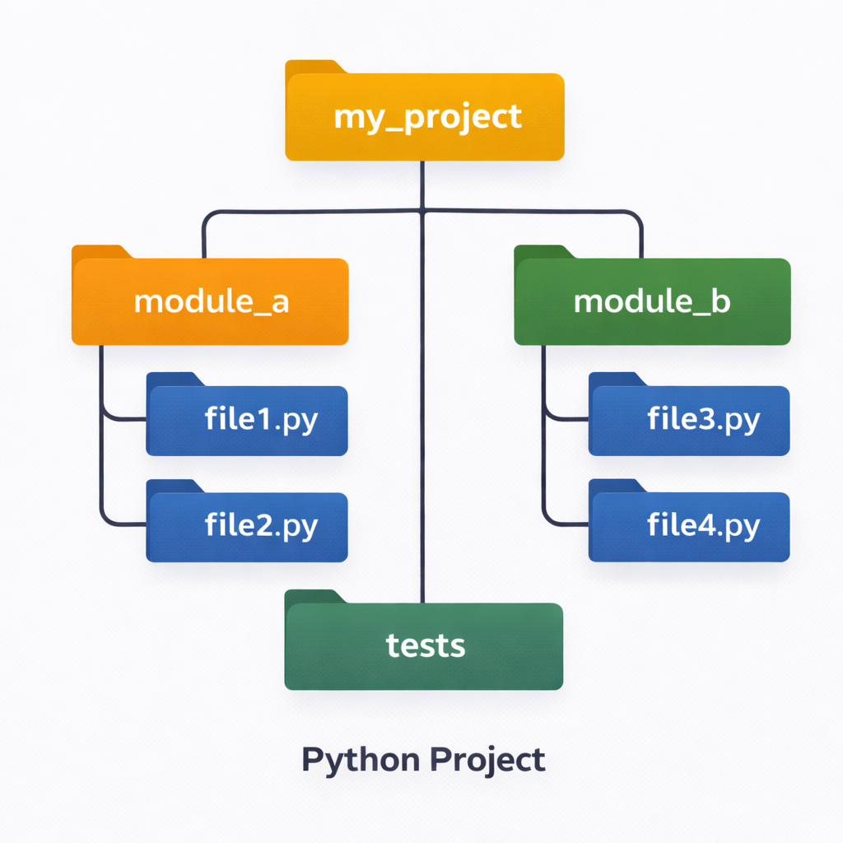
Python Program Architecture
Programs composed of multiple modules
Each file represents one module
Packages group related modules
Clear separation of responsibilities
Entry point controls execution flow
Notes:
Explain that main.py is often the entry point, while logic lives in helper modules. This structure scales well as projects grow.

Slide 5
Code Example
project/
│── main.py
│── utils/
│ ├── __init__.py
│ └── helpers.py

Slide 6
Imports and Attributes
import module loads a module
from module import name imports attributes
Attributes include variables, functions, classes
Dot notation accesses attributes
Imports run module code once
Code Example
import math
print(math.pi)
print(math.sqrt(16))
Notes:
Clarify that modules are objects. math.pi and math.sqrt are attributes inside the math module.

Slide 7
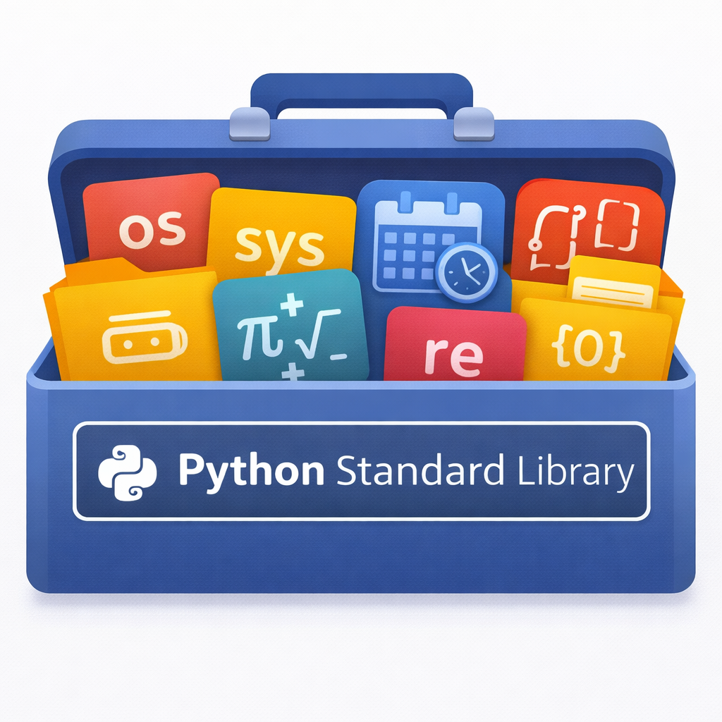
Standard Library Overview
Built-in collection of Python modules
No external installation required
Covers files, OS, math, networking
Well-tested and optimized
“Batteries included” philosophy
Notes:
Highlight how much functionality Python gives for free. Mention common modules like os, sys, json, datetime.

Slide 8
Code Example
import datetime
today = datetime.date.today()
print(today)

Slide 9
How Imports Work
Code Example
# demo.py
print("Module is running")
# main.py
import demo
import demo # runs only once
Python searches for the module
Module code is executed
Module object is created
Names are bound in namespace
Cached for future imports
Notes:
Explain that the print statement runs only on the first import, proving that Python caches loaded modules.

Slide 10
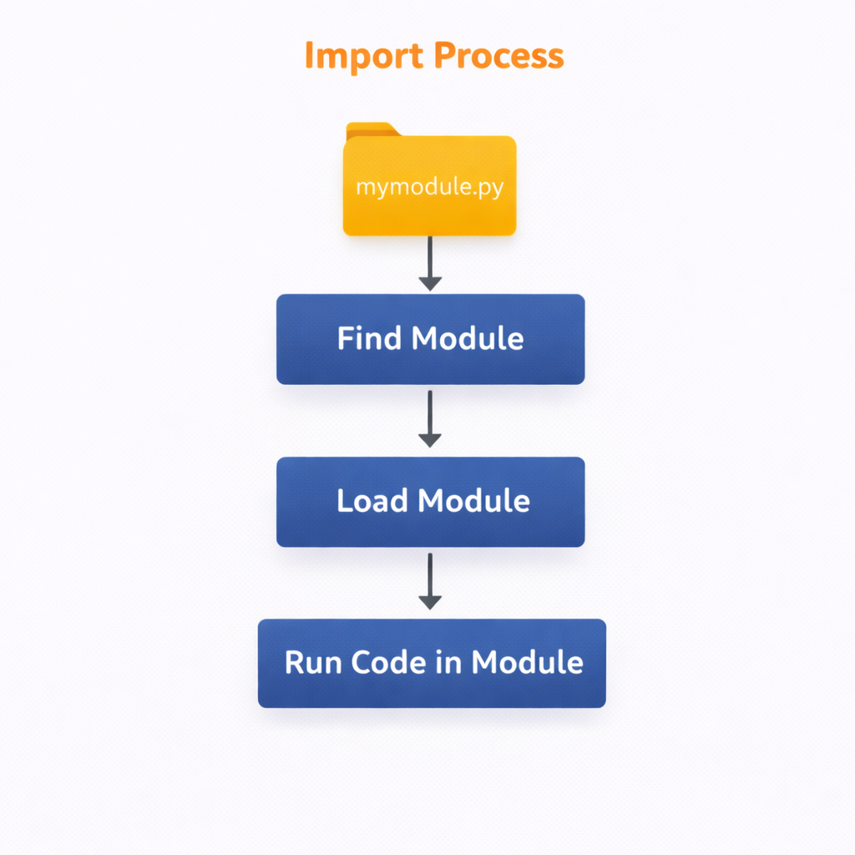

Slide 11
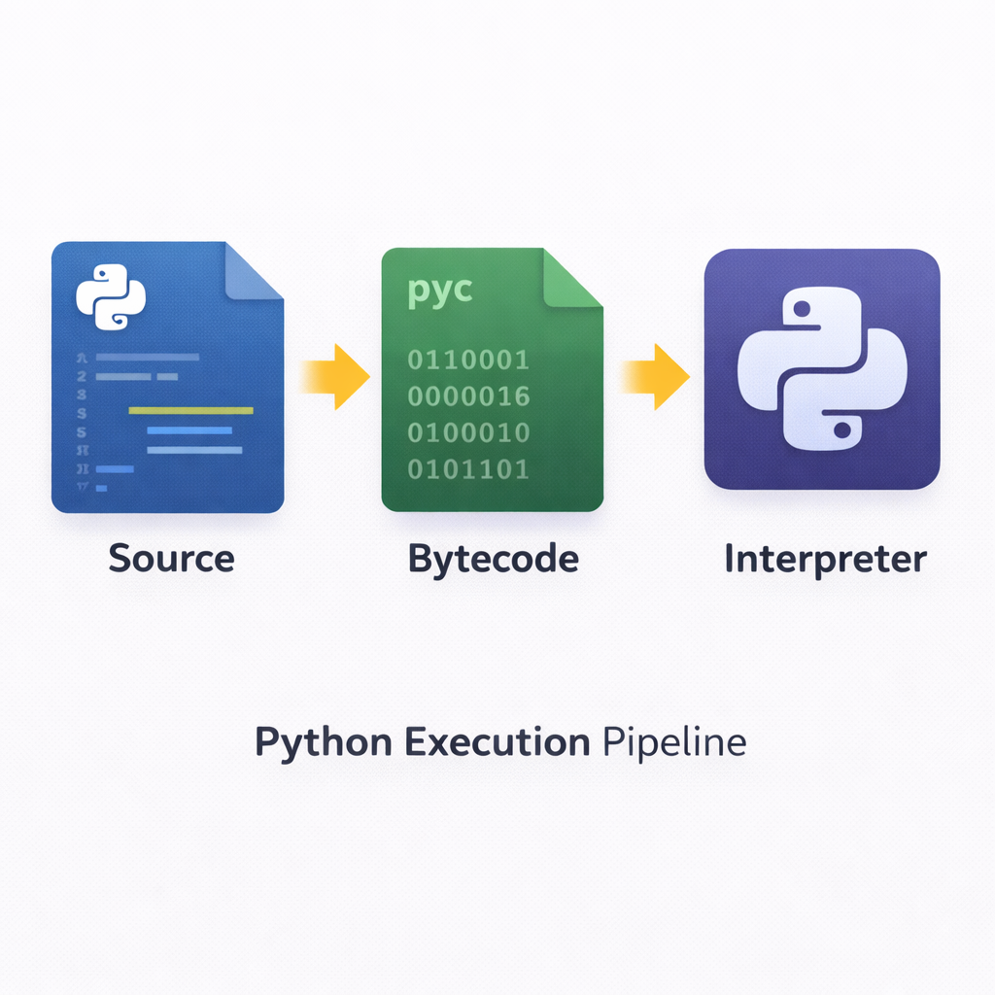
Find → Compile → Run
Python locates source file
Source compiled to bytecode
Bytecode executed by interpreter
Happens automatically
Improves performance
Notes:
Stress that developers don’t manually compile Python. This process is invisible but important for understanding performance and imports.

Slide 12
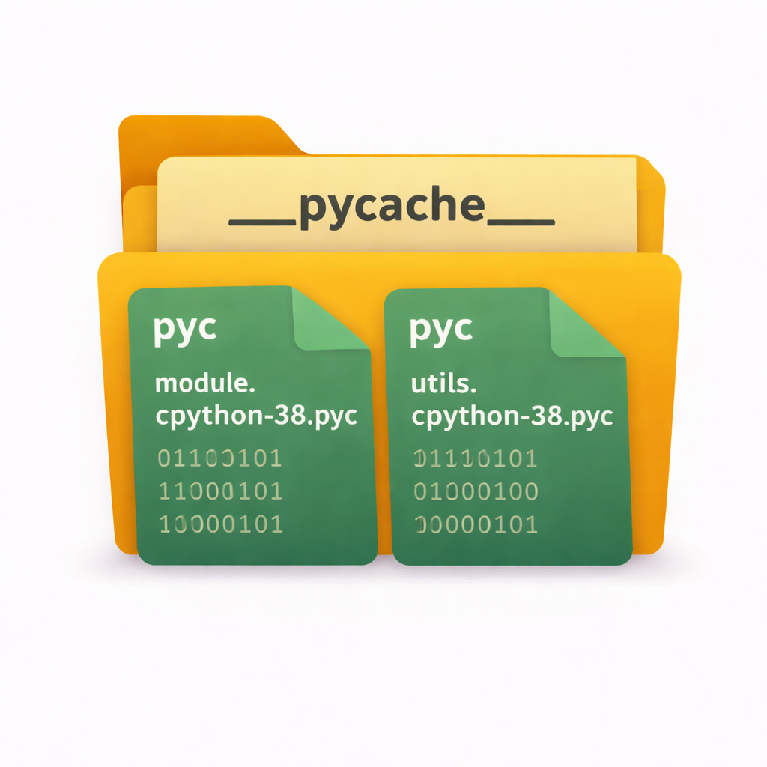
Bytecode & __pycache__
Bytecode stored as .pyc files
Saved in __pycache__ directory
Version-specific bytecode
Speeds up future runs
Automatically managed by Python
Notes:
Explain that deleting __pycache__ is safe. Python regenerates it automatically when needed.

Slide 13
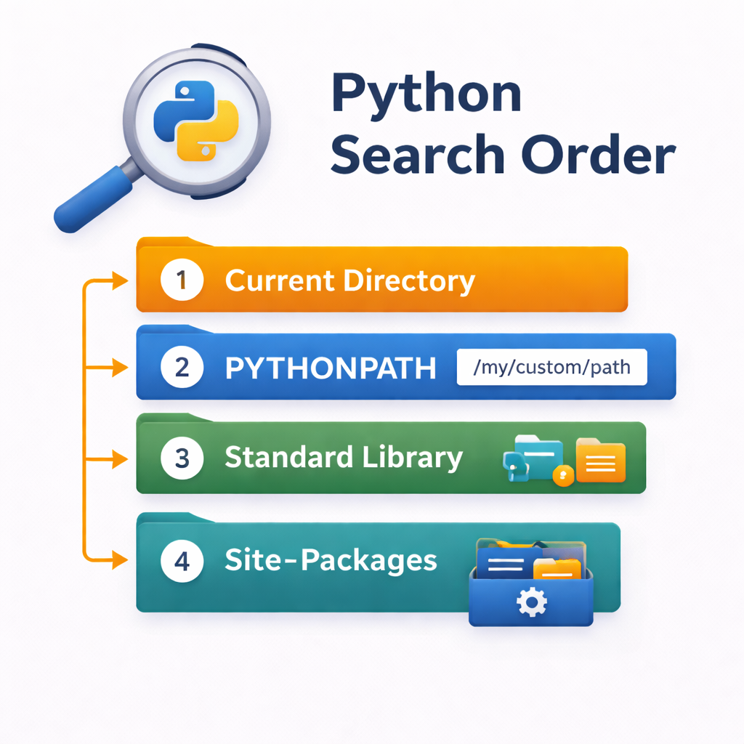
Module Search Path (sys.path)
List of directories Python searches
Current script directory first
Standard library locations
Site-packages for external modules
Accessible via sys.path
import sys
for path in sys.path:
print(path)
Notes:
Explain how Python decides where to look for modules and why incorrect paths cause ModuleNotFoundError.

Slide 14
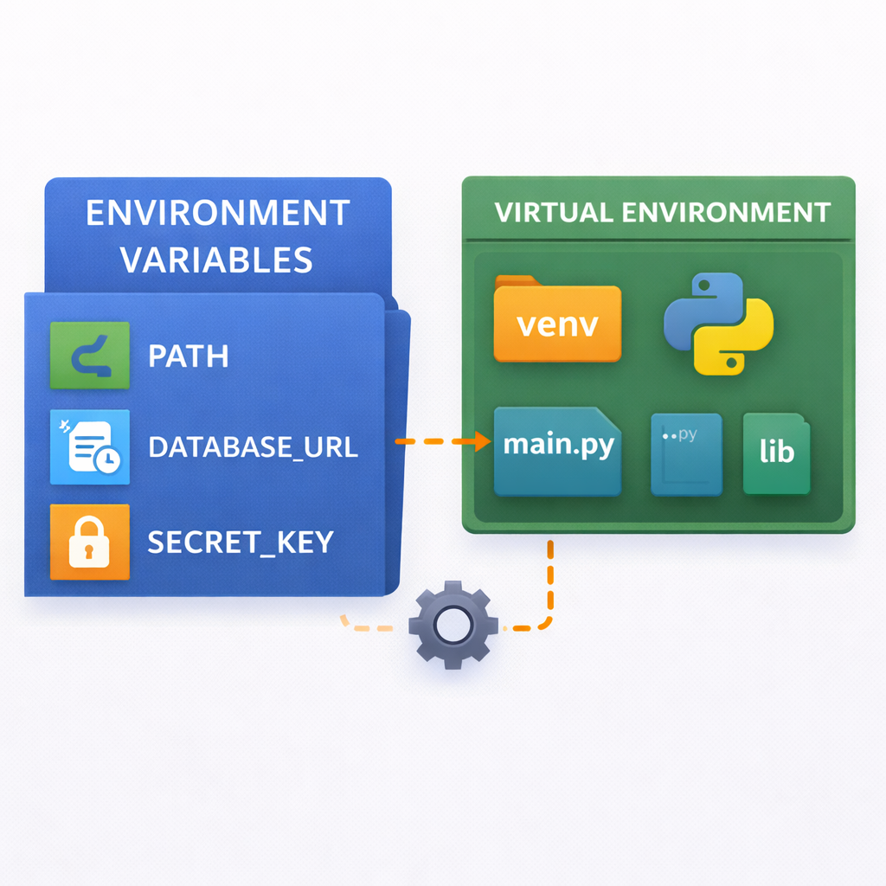
Search Path Configuration
Code Example
import sys
sys.path.append("/my/custom/modules")
Modify sys.path at runtime
Use PYTHONPATH environment variable
Virtual environments control paths
Project structure affects imports
Best practices prevent conflicts
Notes:
Warn that modifying sys.path directly is usually a last resort. Recommend virtual environments and clean project layouts.

Slide 15
Session Summary – Modules Big Picture
Modules structure Python programs
Imports control code visibility
Standard library is powerful
Python manages compilation automatically
Understanding imports prevents bugs
Notes:
Wrap up by reinforcing that understanding modules is essential before moving to packages, virtual environments, and real-world applications.

